Slide 1
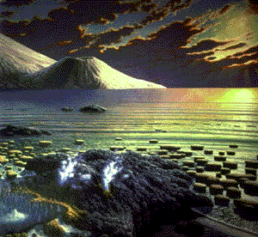
The Origin of Life on Earth

Slide 2
I. Origin of the Earth and Life
a) Scientific estimates place the origin of the Universe at between 10 and 20 billion years ago.
b) The Big Bang Theory, the idea that all matter in the Universe existed in a cosmic egg (smaller than the size of a modern hydrogen atom) that exploded, forming the Universe.
c) Evidence for the Big Bang includes:
1. The Red Shift:
When stars/galaxies are moving away from us the energy they emit is shifted to the red side of the visible-light spectrum. Those moving towards us are shifted to the violet side. This shift is an example of the Doppler effect.

Slide 3
2) Background radiation:
Two Bell Labs scientists discovered that in interstellar space there is a slight background radiation, thought to be the residual after blast remnant of the Big Bang.
II. Where did life originate and how?
a) Extra-terrestrial:
Meteorites have been shown to contain amino acids, the building blocks of proteins, one of the four organic molecule groups basic to all life (Allende, Mexico 1969).
The idea of panspermia hypothesized that life originated out in space and came to earth inside a meteorite.

Slide 4
b) Organic Chemical Evolution:
1. Russian scientist and academecian A.I. Oparin, in 1922, hypothesized that cellular life was preceeded by a period of chemical evolution.
These chemicals, he argued, must have arisen spontaneously under conditions exisitng billions of years ago (and quite unlike current conditions).
2. Stanley Miller (1950) designed an experimental test for Oparin's hypothesis. Oparin's original hypothesis called for :
1) little or no free oxygen (oxygen not bonded to other elements).
2) C H O and N in abundance.

Slide 5
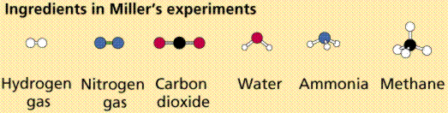
Studies of modern volcanic eruptions support inference of the existence of such an atmosphere.
Miller discharged an electric spark into a mixture thought to resemble the primordial composition of the atmosphere.
From the water receptacle, designed to model an ancient ocean, Miller recovered amino acids.

Slide 6
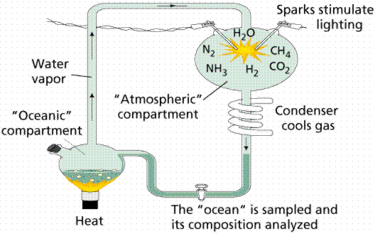
Miller-Urey Experiment

Slide 7
Primitive Conditions on Earth
a) Primordial Earth
1. Great amounts of energy including geothermal, radiant, and electrical.
2. Primitive Oceans
A "soup" of organic compounds that formed by inorganic processes.
Miller's (and subsequent) experiments have not proven life originated in this way, only that conditions thought to have existed over 3 billion years ago were such that the spontaneous (inorganic) formation of organic macromolecules could have taken place.

Slide 8
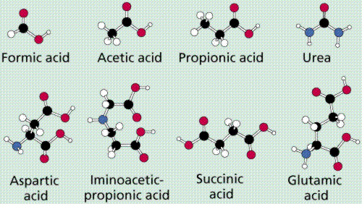
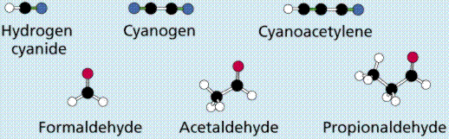
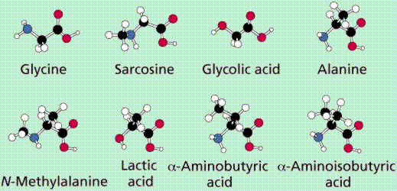
The simple inorganic molecules that Miller placed into his apparatus, produced a variety of complex molecules:
Molecules recovered from Miller's and similar experiments. Image from Purves et al., Life: The Science of Biology, 4th Edition, by Sinauer Associates (www.sinauer.com) and WH Freeman (www.whfreeman.com), used with permission.

Slide 9
The interactions of these molecules would have increased as their concentrations increased.
Reactions would have led to the building of larger, more complex molecules.
A pre-cellular life would have began with the formation of nucleic acids. Eventually the pre-cells would have been enclosed in a lipid-protein membrane, which would have resulted in the first cells.

Slide 10
IV. Biochemical separation of living and non-living systems
a) Living systems:
1. Replicate from one generation to another.
Recent evidence (ribozymes) suggests that RNA may have been the first nucleic acid system to have formed.
2. Show the presence of enzymes and other complex molecules essential to the processes needed by living systems.
3. A membrane that separates the internal chemicals from the external chemical environment.
This delimits the cell from not-cell areas.

Slide 11
b) Evidence of Early Life: The Precambrian Era (Archean Eon)
(From formation of the earth until 2.5 billion years ago)
1. Fossil evidence supports the origins of life on earth earlier than 3.5 billion years ago.
These ancient fossils occur in marine rocks, (limestones and sandstones) that formed in ancient oceans.
2. The earliest forms of life were simple prokaryotic cells.
3. Specimens from the North Pole region of Western Australia are of such diversity and apparent complexity that even more primitive cells must have existed earlier
4. The organisms living today that are most similar to ancient life forms are the archaebacteria which are mostly extremophiles.

Slide 12
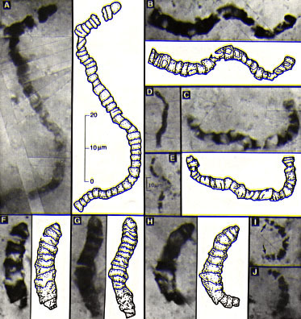
Microfossils from the Apex Chert, North Pole, Australia
These organisms are Archean in age, approximately 3.465 billion years old, and resemble filamentous cyanobacteria.
Image from http://www.astrobiology.ucla.edu/ESS116/L15/1515%20Apex%20Chert.jpg

Slide 13
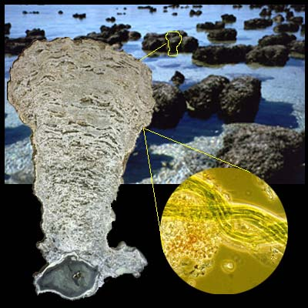
5. Many of the ancient phototrophs and heterotrophic bacteria lived in colonial associations known as stromatolites.
Cyanobacteria occur on the outer surface, with other photosynthetic bacteria (anoxic, which do not produce oxygen from their photosynthesis process) below them.
Below these phototrophs are layers of heterotrophic bacteria.
Image of Sharks Bay, Australia extant stromatolites, a cross section of one of these structures, and a closeup of the cyanobacteria that make up the bulk of the feature. Image from http://www.dme.wa.gov.au/ancientfossils/sharkbay2.jpg

Slide 14
c) The Proterozoic Eon (2.5 billion to 544 million years)
1. Simple, prokaryotic cells still dominated the world's environments.
2. The evolution of simple eukaryotes occurred approximately 1.5-1.2 billion years ago.
3. The significance of the appearance of eukaryotes is the development of sexual reproduction, which greatly increased the variation that natural selection could operate on.
4. A major environmental change was the development of oxygenic photosynthesis.
This led to increasing oxygen levels during later Proterozoic.
5. The first protist (eukaryotic) fossils have commonly been thought to be in rocks approximately 1.2-1.4 billion years old (Bitter Springs Formation, Australia).

Slide 15
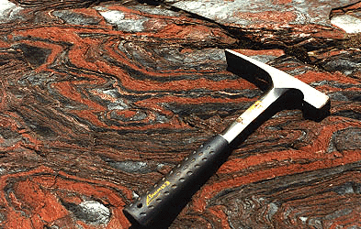
Banded iron formation, illustrating the alternating layers of magnetite and hematite (the red iron) and chert.
Image from http://www.agso.gov.au/education/factsheet/ironform.html

Slide 16
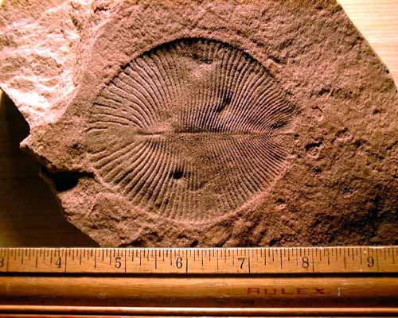
IV. The Origins of Multicellularity: The Vendian Period (650 to 544 million years ago)
a) Multicellularity allows specialization of function.
b) All known Proterozoic animal fossils had soft body parts: no shells or hard (and hence preservable as fossils) parts.
Dickinsonia sp. a Vendian animal fossil thought related to the annelid worms.
Image is from http://www.ucmp.berkeley.edu/vendian/dickinsonia.jpg

